Slide 1

Organizational Behavior
(MGT-502)
Lecture-30

Slide 2
Basic OB Model
Organization
systems level
Group
level
Individual
level

Slide 3
Today’s Topics

Slide 4
Organization Behavior
“One man’s red tape is another man’s system”
  D. Waldo

Slide 5
What are organizations?
Social entities
Goal oriented
Deliberately structured
Linked to the external environment

Slide 6
Creating Effective Organizations

Slide 7
Characteristics Common to All Organizations
Hierarchy of authority
Coordination of effort
Division of labor
Common goal

Slide 8
Organizational Structure and Design
Organizational Structure
  The formal pattern of how people and jobs are grouped in an organization.
Organizational Design
  The decisions and actions that result in organizational structure.

Slide 9
What Determines
Organizational Structure?
To what degree are tasks subdivided into separate jobs?
On what basis will jobs be grouped together?
To whom do individuals and groups report?
How many individuals can a manager efficiently and effectively direct?
Where does decision-making authority lie?
To what degree will there be rules and regulations to direct employees and managers?

Slide 10
Organization Structure: Its Determinants and Outcomes
Causes
Strategy
Size
Technology
Environment
determines
Structural
designs
leads to
Mechanistic
Organic
Moderated by
Individual
Differences
Performance
and
Satisfaction

Slide 11
The Basics of Organizational Structure
Organizational structure defines how job tasks are formally divided, grouped, and coordinated.
The organization chart is a visual representation of this division, grouping, and coordination.

Slide 12
The Basics of Organizational Structure
Division of Labor
  Specialization
    Horizontal differentiation
    Vertical differentiation
    Personal differentiation

Slide 13
The Basics of Organizational Structure
Coordinating Mechanisms
  Mutual Adjustment
  Direct Supervision
  Standardization of Work Processes
  Standardization of Outputs
  Standardization of Skills

Slide 14
The Basics of Organizational Structure
The Nature of the Hierarchy
  Chain of Command - describes reporting relationships - illustrated by the organization chart
  Span of Control - the number of subordinates reporting to a manager. Can result in “tall” or “flat” organization structures.

Slide 15
The Basics of Organizational Structure
Centralization vs. Decentralization
  Centralization - decisions are made only by those few at the top of the organization
  Decentralization - decision-making responsibility is delegated to people at all levels in the organization

Slide 16
The Basics of Organizational Structure
Mechanistic Structures vs. Organic Structures
Division of Labor
Horizontal/Vertical
Differentiation
Clear Chain of Command
Narrow Spans of Control
Relatively Centralized
Direct Supervision
Cross-Functional Teams
Personal/Spatial
Differentiation
Multiple Chain of Command
Wide Spans of Control
Relatively Decentralized
Self-Managed

Slide 17
Mechanistic vs. Organic Models
The Mechanistic Model
The Organic Model
High specialization
Rigid departmentalization
Clear chain of command
Narrow spans of control
Centralization
High formalization
Cross-functional teams
Cross-hierarchical teams
Free flow of information
Wide spans of control
Decentralization
Low formalization

Slide 18
Organizational Structure
How job tasks are formally divided, grouped and coordinated
How parts of organization fit together to coordinate employees to achieve organizational goals.
Formal structure shows the intended configuration of positions, job duties,and the lines of authority among different parts of the enterprise.

Slide 19
The Simple Structure
Abid’s General Store
Abid
Owner, manager
owner, manager
Farooq
Sajjad
Shakir
Rafiq
Riaz
salesperson
salesperson
salesperson
salesperson
Cashier

Slide 20
Six Key Questions That Managers Need to Answer in Designing the Proper Organizational Structure
The Answer
The Key Question Is Provided By
1. To what degree are tasks subdivided into separate jobs?
On what basis will jobs be grouped
together?
To whom do individuals and groups report?
4. How many individuals can a manager
efficiently and effectively handle?
Where does decision -making authority lie?
6. To what degree will there be rule and
regulations to direct employees and managers?
Work specialization
Departmentalization
Chain of command
Span of control
Centralization and
decentralization
Formalization

Slide 21
Work Specialization
The degree to which tasks in the organization are subdivided into separate jobs.

Slide 22
Departmentalization
The basis by which jobs are grouped together.

Slide 23
Chain of Command
Chain of Command
  The unbroken line of authority that extends from the top of the organization to the lowest echelon and clarifies who reports to whom.
Authority
  The rights inherent in a managerial position to give orders and to expect the orders to be obeyed
Unity of Command
  Only one direct superior

Slide 24
Span of Control
The number of subordinates a manger can efficiently and effectively direct.

Slide 25
Span of Control
Organizational Level

Slide 26
Critical Factors Affecting Span of Control
Required Contact
Degree of Specialization
Ability to Communicate

Slide 27
Centralization
The concentration of authority and responsibility for decision making in the hands of managers at the top of an organization’s hierarchy (the degree to which decision making is concentrated at a single point in the organization)

Slide 28
Decentralization
Distribution of authority and responsibility for decision making to managers at all levels of an organization’s hierarchy (decision discretion is pushed down to lower -level employees)

Slide 29
Formalization
The degree to which jobs within the organization are standardized.

Slide 30
Organization Design Options
Virtual Design
Complex
Network Design
Multinational Design
Environmental
Factors
Multidivisional Design
Product Design
Place Design
Simple
Functional Design
Pooled
Technological Factors
Reciprocal

Slide 31
Organizational Design Components
Components
Design Decisions
Division of Labor
Specialization
High
Low
Authority
Delegation
High
Low
Departmentalization
Basis
Homogenous
Heterogeneous
Span of Control
Number
Few
Many

Slide 32

Organizational Design Models
The Mechanistic Model
The Organic Model
The Matrix Model

Slide 33
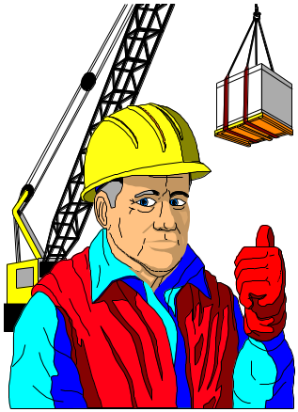
The Mechanistic Model
The type of organizational design that emphasizes the importance of production and efficiency. It is highly formalized, centralized, and complex.

Slide 34
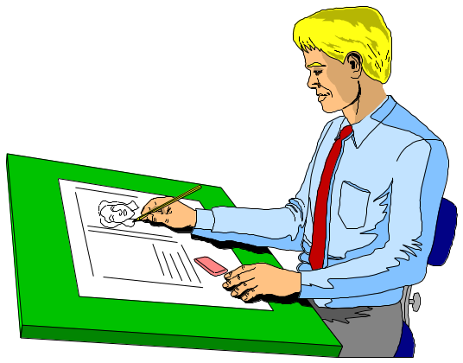
The Organic Model
The organizational design that emphasizes the importance of adaptability and development. It is relatively informed, decentralized, and simple.

Slide 35
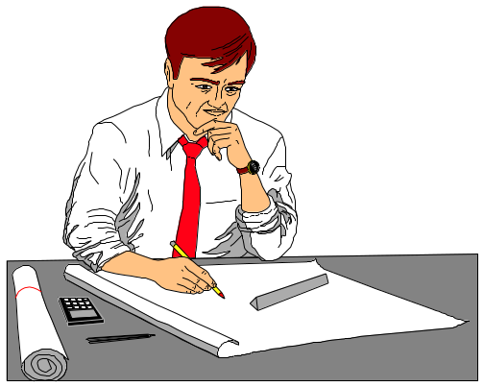
The Matrix Model
An organizational design that superimposes a product- or project-based design on an existing function-based design.

Slide 36
Why Do Structures Differ?
Strategy
  Innovation, cost minimization, and imitation.
Organization Size
  An organization’s size significantly affects its structure.
  The relationship isn’t linear, rather size affects structure at a decreasing rate.
Technology
  Every organization has at least one technology for converting financial, human, and physical resources into products or services
  The common theme that differentiates technologies is their degree of routineness.
Environment
  composed of forces outside the organization and the uncertainty associated with them.

Slide 37

Early-Warning Signs of Decline
Excess personnel
Tolerance of incompetence
Cumbersome administrative procedures
Disproportionate staff power
Scarcity of clear goals and decision benchmarks
Fear of embarrassment and conflict

Slide 38
Early-Warning Signs of Decline Cont.
6) Loss of effective communication
7) Outdated organizational structure
Increased scapegoating by leaders
Resistance to change
Low morale
Special interest groups are more vocal
Decreased innovation

Slide 39
The Effect of Technology on Structure
The more the technology requires interdependence between individuals and/or groups, the greater the need for coordination
“As technology moves from routine to nonroutine, subunits adopt less formalized and centralized structures”

Slide 40
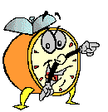
Let’s stop it here

Slide 41
Summary

Slide 42
Characteristics Common to All Organizations
Hierarchy of authority
Coordination of effort
Division of labor
Common goal

Slide 43
Organizational Structure and Design
Organizational Structure
  The formal pattern of how people and jobs are grouped in an organization.
Organizational Design
  The decisions and actions that result in organizational structure.

Slide 44
Organization Structure: Its Determinants and Outcomes
Causes
Strategy
Size
Technology
Environment
determines
Structural
designs
leads to
Mechanistic
Organic
Moderated by
Individual
Differences
Performance
and
Satisfaction

Slide 45
Six Key Questions That Managers Need to Answer in Designing the Proper Organizational Structure
The Answer
The Key Question Is Provided By
1. To what degree are tasks subdivided into separate jobs?
On what basis will jobs be grouped
together?
To whom do individuals and groups report?
4. How many individuals can a manager
efficiently and effectively handle?
Where does decision -making authority lie?
6. To what degree will there be rule and
regulations to direct employees and managers?
Work specialization
Departmentalization
Chain of command
Span of control
Centralization and
decentralization
Formalization

Slide 46
Organizational Design Components
Components
Design Decisions
Division of Labor
Specialization
High
Low
Authority
Delegation
High
Low
Departmentalization
Basis
Homogenous
Heterogeneous
Span of Control
Number
Few
Many

Slide 47
Organizational Design Models
The Mechanistic Model
The Organic Model
The Matrix Model

Slide 48
Strategy
Organization
Size
Why Do
Structures
Differ?
Technology
Environment

Slide 49
Next….

Slide 50
Organizational Behavior
(MGT-502)
Lecture-30

